Slide 1
MODULE IV ADVANCED FEATURES OF JAVA

Slide 2
Syllabus
Event handling - Event Handling Mechanisms, Delegation Event Model, Event Classes, Sources of Events, Event Listener Interfaces, Using the Delegation Model.

Slide 3
EVENT
When the user interacts with a GUI application, an event is generated. Examples of user events are clicking a button, selecting an item or closing a window. Events are represented as Objects in Java.
Change in the state of an object is known as event i.e. event describes the change in state of source.
Events are generated as result of user interaction with the graphical user interface components.
For example, clicking on a button, moving the mouse, entering a character through keyboard, selecting an item from list, scrolling the page are the activities that causes an event to happen.
Types of Event
The events can be broadly classified into two categories:

Slide 4
Foreground Events
Those events which require the direct interaction of user. They are generated as consequences of a person interacting with the graphical components in Graphical User Interface. For example, clicking on a button, moving the mouse, entering a character through keyboard, selecting an item from list, scrolling the page etc.
Background Events
Those events that require the interaction of end user are known as background events. Operating system interrupts, hardware or software failure, timer expires, an operation completion are the example of background events.

Slide 5
EVENT HANDLING
Event Handling is the mechanism that controls the event and decides what should happen if an event occurs.
This mechanism have the code which is known as event handler that is executed when an event occurs.
Java Uses the Delegation Event Model to handle the events.
This model defines the standard mechanism to generate and handle the events.
Let's have a brief introduction to this model.

Slide 6
Delegation Event Model
There are three participants in event delegation model in Java;
Event Source – the class which broadcasts the events
Event Listeners – the classes which receive notifications of
events
Event Object – the class object which describes the event.
Its concept is :
A source generates an event and sends it to one or more listeners.
The listener simply waits until it receives an event.
Once received, the listener processes the event and then returns.
The listeners must register with a source in order to receive an event notification.

Slide 7
Advantage :
The benefit of this approach is that the user interface logic is completely separated from the logic that generates the event.
The user interface element is able to delegate the processing of an event to the separate piece of code.
In this model ,Listener needs to be registered with the source object so that the listener can receive the event notification.
This is an efficient way of handling the event because the event notifications are sent only to those listener that want to receive them.

Slide 8
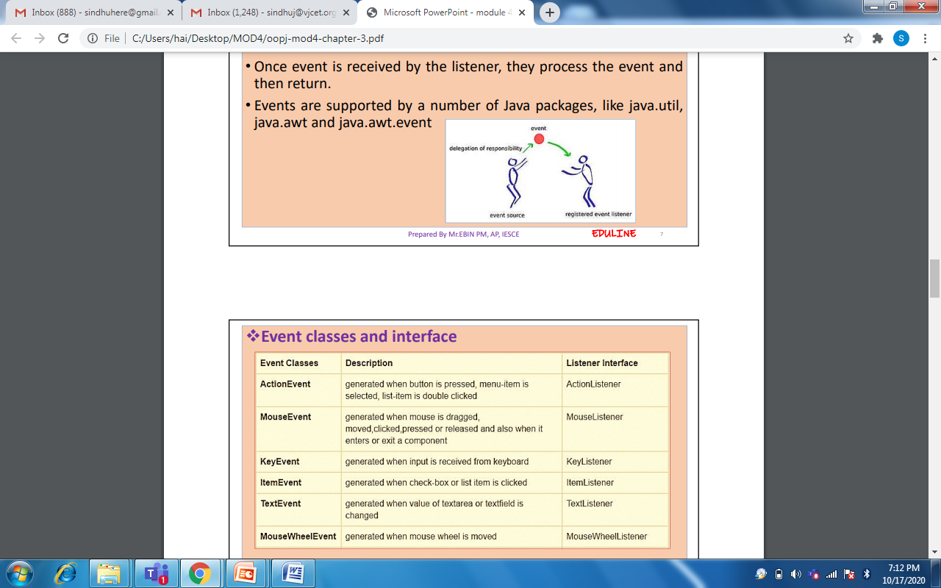
How Events are handled
A source generates an Event and send it to one or more listeners registered with the source.
Once event is received by the listener, they process the event and then return.
Events are supported by a number of Java packages, like java.util, java.awt and java.awt.event

Slide 9
Event Model : Event
An event is an object that describes a state change in a source or it is a type of signal to the program that something has happened.eg. Button pressed, window closed etc.
It can be generated by
Personal interaction
Example : Pressing a button, entering a character via the keyboard, selecting an item in a list, and clicking the mouse etc.
Not directly caused by personal interactions
Example : An event may be generated when a timer expires, a counter exceeds a value, a software or hardware failure occurs, an operation is completed etc.

Slide 10
Event Model : Event Sources
A source is an object that generates an event.
A source must register listeners in order for the listeners to receive notifications about a specific type of event.
General form: public void addTypeListener(TypeListener el)
Type - event name
el - reference to the event listener.
Example :
addKeyListener() :The method that registers a keyboard event listener
addMouseMotionListener() :The method that registers a mouse motion listener

Slide 11
Sources may generate more than one type of event.
Multicasting: When an event occurs, all registered listeners are notified and receive a copy of the event object. The notifications are sent only to listeners that register to receive them.
Unicasting: Some sources may allow only one listener to register.
public void addTypeListener(TypeListener el)
throws java.util.TooManyListenersException
Unregister a specific type of event
public void removeTypeListener(TypeListener el)
Type - event name
el - reference to the event listener.
Example :
removeKeyListener( ) :To remove a keyboard listener

Slide 12
Event Model : Event Listener
A listener is an object that is notified when an event occurs.
It has two major requirements.
It must have been registered with one or more sources to receive notifications about specific types of events.
It must implement methods to receive and process these notifications. These methods are defined in a set of interfaces found in java.awt.event.
Example: MouseMotionListener interface defines two methods to receive notifications when the mouse is dragged or moved. Any object may receive and process one or both of these events if it provides an implementation of this interface.

Slide 13
Event Classes
The classes that represent events are the core of java’s event handling. There are many event classes.
EventObject
superclass for all events
defined inside java.util package
constructor : EventObject(Object src)
src – object that generates event
two methods:
Object getSource( ) : returns the event source
toString( ) : returns the string equivalent of the event
AWTEvent
subclass of EventObject.
superclass of all AWT-based events
defined within the java.awt package
int getID( ) – returns an integer that determine the event type

Slide 14
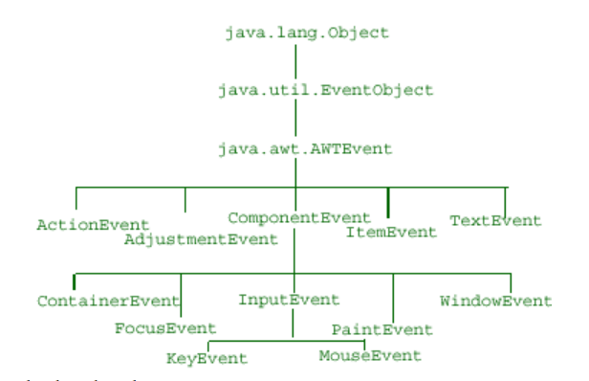
Event class hierarchy

Slide 15
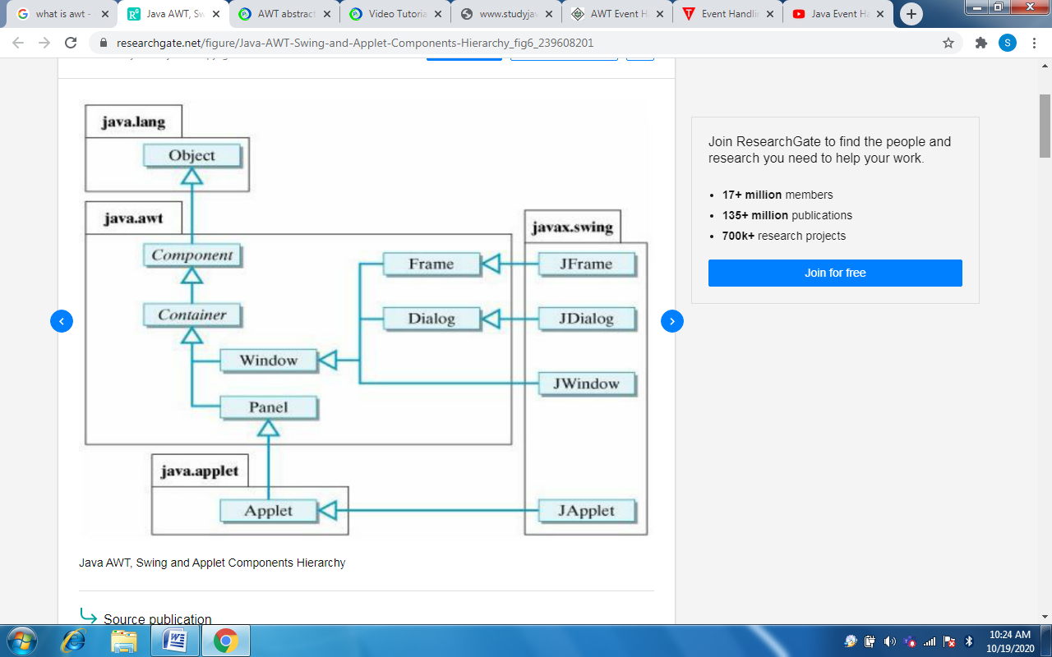

Slide 16
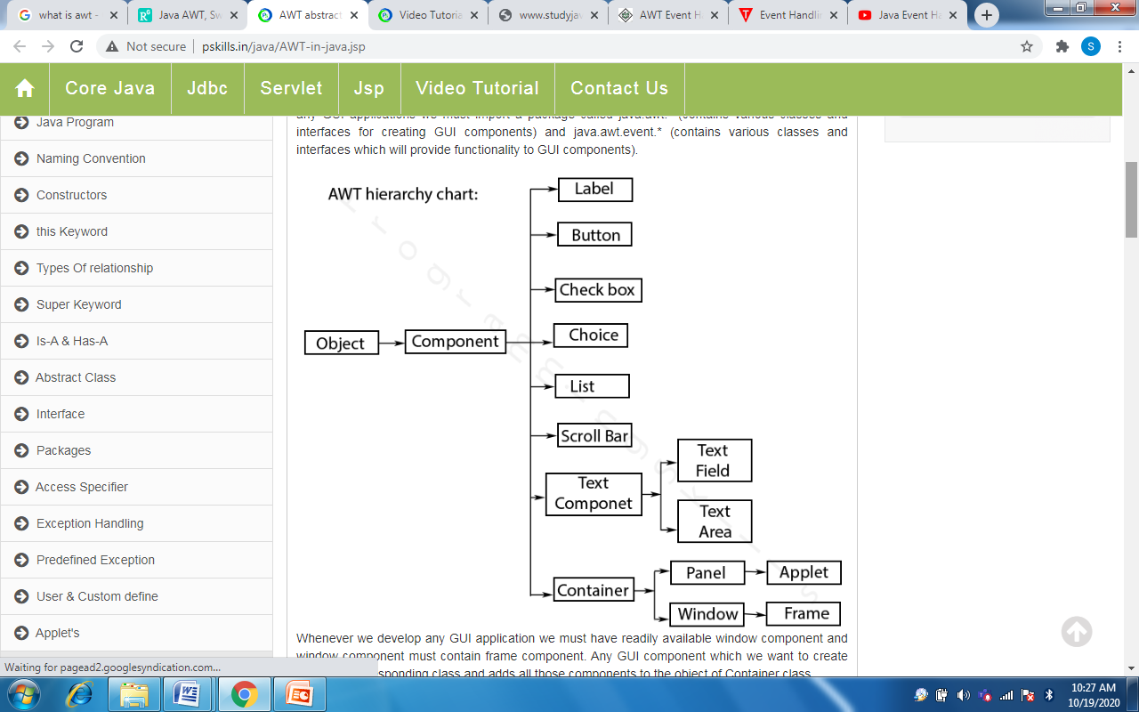

Slide 17
AWT
AWT stands for Abstract Window Toolkit.
It is a platform dependent API for creating Graphical User Interface (GUI) for java programs.
Why AWT is platform dependent? Java AWT calls native platform (Operating systems) subroutine for creating components such as textbox, checkbox, button etc. In simple, an application build on AWT would look like a windows application when it runs on Windows, but the same application would look like a Mac application when runs on Mac OS.
AWT is rarely used now days because of its platform dependent and heavy-weight nature.

Slide 18
Components and containers
All the elements like buttons, text fields, scrollbars etc are known as components.
In AWT we have classes for each component as shown in the above diagram.
To have everything placed on a screen to a particular position, we have to add them to a container.
A container is like a screen wherein we are placing components like buttons, text fields, checkbox etc.
In short a container contains and controls the layout of components.
A container itself is a component (shown in the above hierarchy diagram) thus we can add a container inside container.

Slide 19
Types of containers: As explained above, a container is a place wherein we add components like text field, button, checkbox etc. There are four types of containers available in AWT: Window, Frame, Dialog and Panel. As shown in the hierarchy diagram above, Frame and Dialog are subclasses of Window class.
Window: An instance of the Window class has no border and no title
Dialog: Dialog class has border and title. An instance of the Dialog class cannot exist without an associated instance of the Frame class.
Panel: Panel does not contain title bar, menu bar or border. It is a generic container for holding components. An instance of the Panel class provides a container to which to add components.
Frame: A frame has title, border and menu bars. It can contain several components like buttons, text fields, scrollbars etc. This is most widely used container while developing an application in AWT.

Slide 20
Creating a Frame
1) By extending Frame class 2) By creating the instance of Frame class
Methods
public void add(Component c)
public void setSize (int width, int height)
public void setLayout(LayoutManager m)
public void setVisible(boolean status)

Slide 21
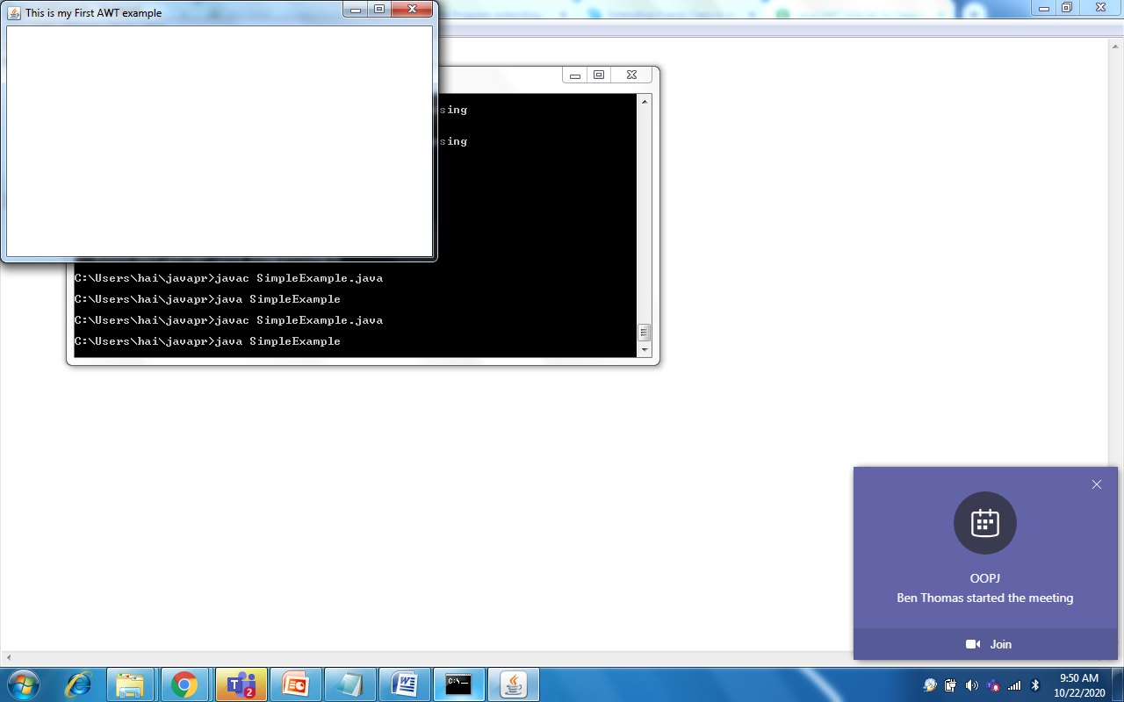
Example 1: Creating Frame By extending Frame class
import java.awt.*;
public class Frame1 extends Frame{
Frame1(){
setSize(500,300);
setTitle("This is my First AWT example"); Output
setLayout(null);
setVisible(true);
}
public static void main(String args[]){
Frame1 f=new Frame1();
}
}

Slide 22
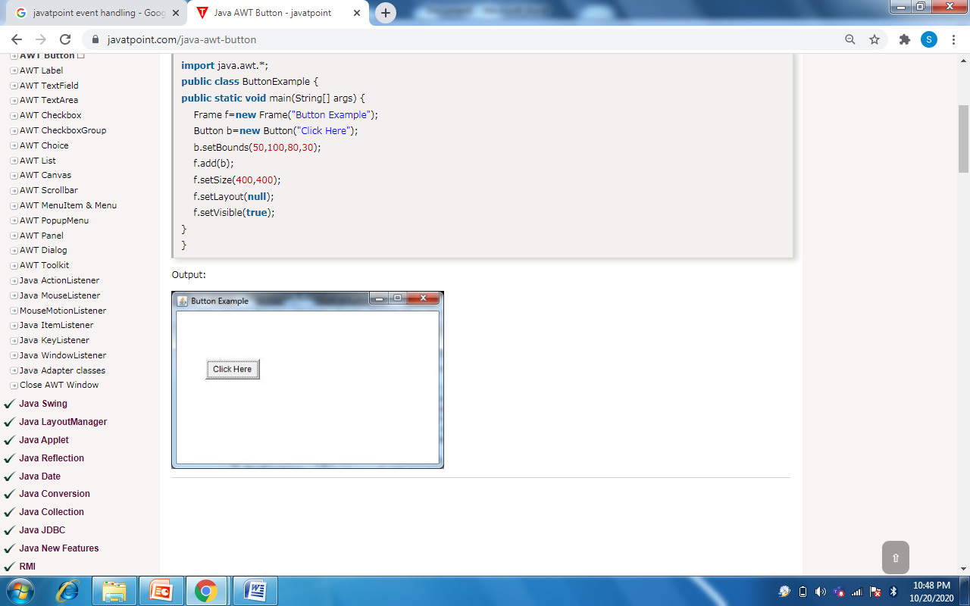
Example 2: Creating Frame using instance of Frame class
import java.awt.*;
public class ButtonExample {
public static void main(String[] args) {
Frame f=new Frame("Button Example");
Button b=new Button("Click Here");
b.setBounds(50,100,80,30);
f.add(b);
f.setSize(400,400);
f.setLayout(null);
f.setVisible(true);
}
}
Output:

Slide 23
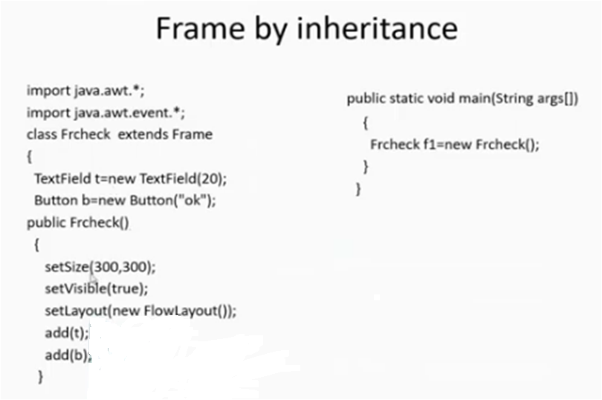
Example 3

Slide 24
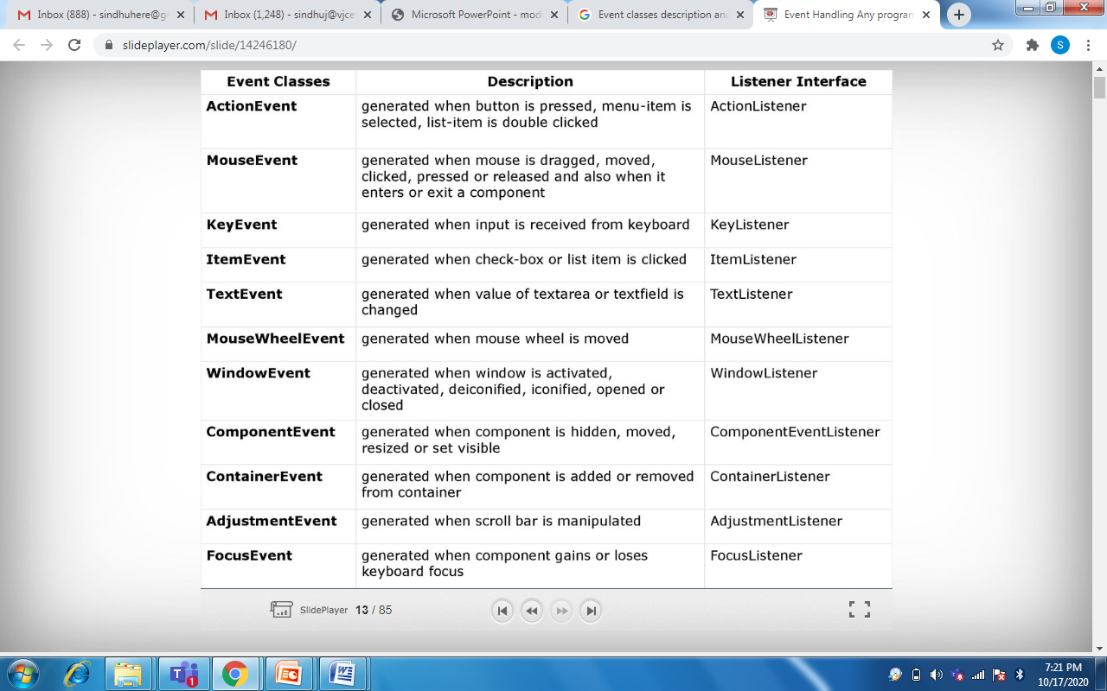
Event classes and interface

Slide 25
Steps involved in event handling
The User clicks the button and the event is generated.
Now the object of concerned event class is created automatically and information about the source and the event get populated with in same object.
Event object is forwarded to the method of registered listener class.
The method is now get executed and returns.

Slide 26
Points to remember about listener
In order to design a listener class we have to develop some listener interfaces.
These Listener interfaces forecast some public abstract callback methods which must be implemented by the listener class.
If we do not implement the predefined interfaces then your class can not act as a listener class for a source object.

Slide 27
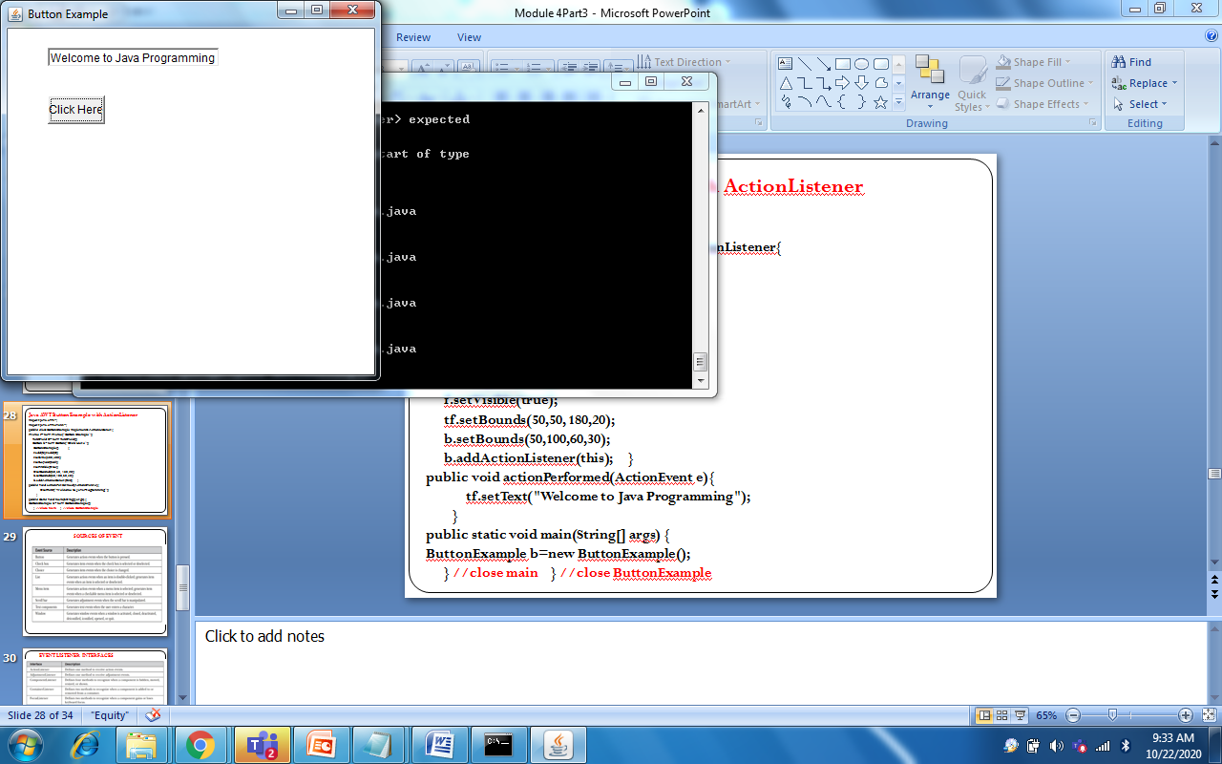
Java AWT Button Example with ActionListener
import java.awt.*;
import java.awt.event.*;
public class ButtonExample implements ActionListener{
Frame f=new Frame("Button Example"); Output
TextField tf=new TextField();
Button b=new Button("Click Here");
ButtonExample() {
f.add(b); f.add(tf);
f.setSize(400,400);
f.setLayout(null);
f.setVisible(true);
tf.setBounds(50,50, 180,20);
b.setBounds(50,100,60,30);
b.addActionListener(this); }
public void actionPerformed(ActionEvent e){
tf.setText("Welcome to Java Programming");
}
public static void main(String[] args) {
ButtonExample b=new ButtonExample();
} //close main } //close ButtonExample

Slide 28
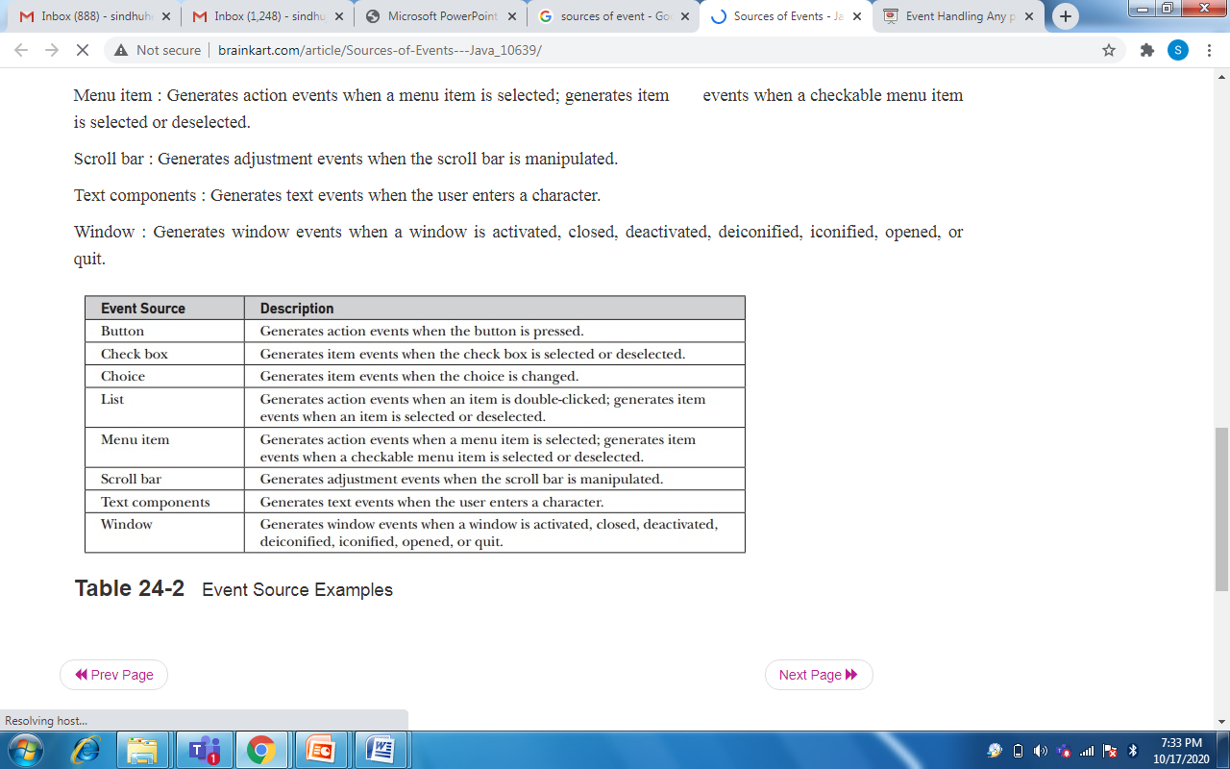
SOURCES OF EVENT

Slide 29
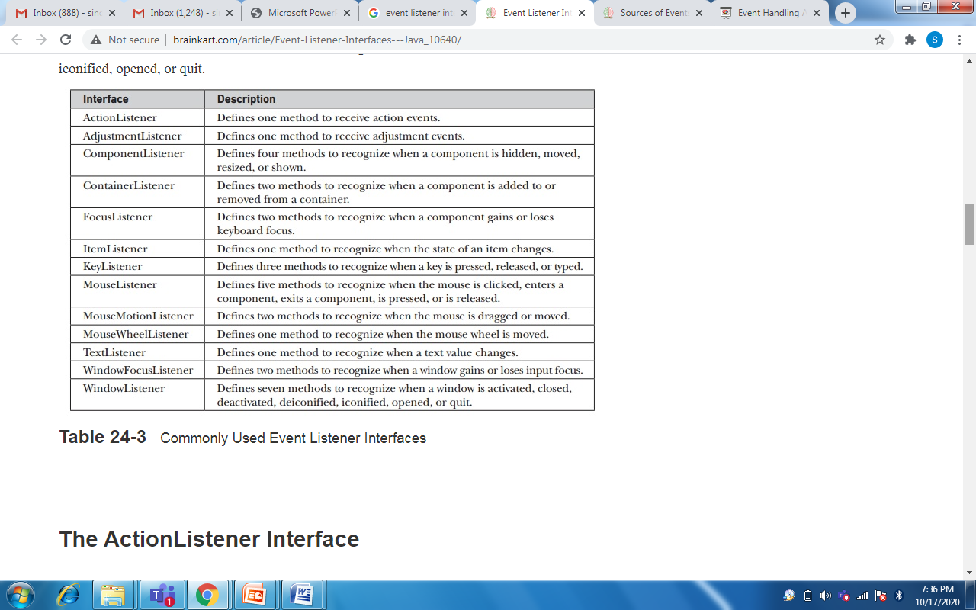
EVENT LISTENER INTERFACES

Slide 30
The ActionListener Interface
Defines actionPerformed() method that is invoked when an action event occurs.
void actionPerformed(ActionEvent ae)
The AdjustmentListener Interface
Defines adjustmentValueChanged method that is invoked when an adjustment event occurs.
void adjustmentValueChanged(AdjustmentEvent ae)
The ComponentListener Interface
Defines four methods that is invoked when a component is resized, moved, shown or hidden
void componentResized(ComponentEvent ce)
void componentMoved(ComponentEvent ce)
void componentShown(ComponentEvent ce)
void componentHidden(ComponentEvent ce)

Slide 31
The ContainerListener Interface
Defines two methods. Respective methods are called when a component is added or removed from a container.
void componentAdded(ContainerEvent ce)
void componentRemoved(ContainerEvent ce)
The FocusListener Interface :
defines two methods. Respective methods are called when keyboard obtains and loses focus
void focusGained(FocusEvent fe)
void focusLost(FocusEvent fe)
The ItemListener Interface
void itemStateChanged(ItemEvent ie)
The KeyListener Interface
void keyPressed(KeyEvent ke)
void keyReleased(KeyEvent ke)
void keyTyped(KeyEvent ke)

Slide 32
The MouseListener Interface
void mouseClicked(MouseEvent me)
void mouseEntered(MouseEvent me)
void mouseExited(MouseEvent me)
void mousePressed(MouseEvent me)
void mouseReleased(MouseEvent me)
The MouseMotionListener Interface
void mouseDragged(MouseEvent me)
void mouseMoved(MouseEvent me)
The MouseWheelListener Interface
void mouseWheelMoved(MouseWheelEvent mwe)

Slide 33
The TextListener Interface
void textChanged(TextEvent te)
The WindowFocusListener Interface
void windowGainedFocus(WindowEvent we)
void windowLostFocus(WindowEvent we)
The WindowListener Interface
void windowActivated(WindowEvent we)
void windowClosed(WindowEvent we)
void windowClosing(WindowEvent we)
void windowDeactivated(WindowEvent we)
void windowDeiconified(WindowEvent we)
void windowIconified(WindowEvent we)
void windowOpened(WindowEvent we)

Slide 35
Applets
Applet is a special type of program that is embedded in the webpage to generate the dynamic content.
There are two types of applets:
The first type use the Abstract Window Toolkit (AWT) to provide the graphic user interface (or use no GUI at all). This style of applet has been available since Java was first created
The second type of applets are those based on the Swing class JApplet. Swing applets use the Swing classes to provide the GUI. Swing offers a richer and often easier-to-use user interface than does the AWT

Slide 36
Application Program Vs Applet Program
Applet does not use main() method for initiating the execution of a code. Applet, when loaded, automatically call certain methods of Applet class to start and execute the applet code.
Applets are not stand-alone programs. Instead, they run within either a web browser or using an applet viewer.
Applets cannot read from or write into a file in the local system.
Applets cannot communicate with each other server on the network.
Applets are restricted from using libraries from other languages such as C or C++.

Slide 37
Applets : Example
Abstract Window Toolkit, for GUI
import java.awt.*; import java.applet.*; public class SimpleApplet extends Applet { public void paint(Graphics g) { g.drawString("A Simple Applet", 20, 20); } }
applet , for Applet class
Always (public and extends Applet)
Called to redraw applet
Over ridden method[class Applet]

Slide 38
Applet Viewer is used to execute applets in this section.
Comment is included at the head of the Java source code file that contains the APPLET tag.
/*
<applet code="SimpleApplet" width=200 height=60>
</applet>
*/
Do the following three steps:
Edit a Java source file with applet tag.
Compile the program.
Execute the applet viewer, specifying the name of your applet’s source file. The applet viewer will encounter the applet tag within the comment and execute the applet.

Slide 39
import java.awt.*; import java.applet.*; /* <applet code="SimpleApplet" width=200 height=60> </applet> */ public class SimpleApplet extends Applet { public void paint(Graphics g) { g.drawString("A Simple Applet", 20, 20); } }
Source code is documented
with prototype of HTML statements
Output
Save file as SimpleApplet.java
Compile: javac SimpleApplet.java
Execute: appletviewer SimpleApplet.java

Slide 40
Applet Architecture
An applet is a window-based program.
Applets are event driven. An applet waits until an event occurs.
The user interacts with the applet when he or she wants.
The AWT notifies the applet about an event by calling an event handler that has been provided by the applet.
The applet must take appropriate action and then quickly return control to the AWT.
Example :
If the user clicks a mouse inside the applet’s window, a mouse-clicked event is generated
If the user presses a key while the applet’s window has input focus, a keypress event is generated.

Slide 41
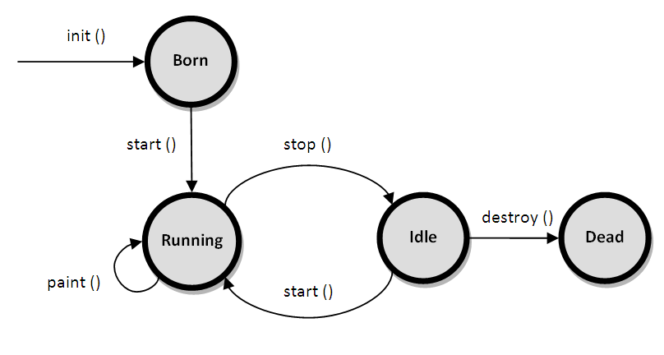
Applet Life Cycle

Slide 42
Born on initialization state :
Applet enters the initialization state when it is first loaded.
This is achieved by calling init().
This occurs only once in the applet’s life cycle.
At this stage, we may do the following
Create objects needed by the applet
Initialize variables
Load images or fonts.
Setup colors.

Slide 43
Running state :
Applet enters this state when the system calls the start() method
This occurs automatically after the applet is initialized(init())
Starting can also occur if the applet is already in stopped(Idle) state.
start() can be called more than once.
start( ) is called each time an applet’s HTML document is displayed onscreen. So, if a user leaves a web page and comes back, the applet resumes execution at start( ).

Slide 44
Idle state or Stopped state :
An applet becomes idle when it is stopped from running. We can do so by calling stop() explicitly.
Stopping occurs automatically when we leave the page containing the currently running applet.
Example : when it goes to another page.
If the user returns to the page, we can restart them by calling start( ).
Dead or destroyed state :
An applet is said to be dead when it is removed from memory.
This occurs by invoking destroy().
At this point, we should free up any resources the applet may be using. The stop( ) method is always called before destroy( ).
This occurs only once in the applet life cycle.

Slide 45
Display state:
Applet moves to this state whenever it has to perform some output operations on the screen.
This happens immediately after the applet enters into the running state.
paint() is called to accomplish this task.
The paint( ) method is called each time our applet’s output must be redrawn.
This situation can occur for several reasons. For example,
the window in which the applet is running may be overwritten by another window and then uncovered.
the applet window may be minimized and then restored.
The paint( ) method has one parameter of type Graphics. This parameter describes the graphics environment in which the applet is running.

Slide 46
Applets override a set of methods
init(), start(), stop(), and destroy() : These are defined by Applet
paint() : It is defined by the AWT Component class.
When an applet begins, the AWT calls the following methods, in this sequence:
init( )
start( )
paint( )
When an applet is terminated, the following sequence of method calls takes place:
stop( )
destroy( )

Slide 47
Applet Display Methods
To output a string to an applet :
drawString( ), which is a member of the Graphics class
void drawString(String message, int x, int y)
message is the string to be output beginning at x,y. In a Java window, the upper-left corner is location 0,0.
To set the background color of an applet’s window, use setBackground( ).
void setBackground(Color newColor)
To set the foreground color, use setForeground( ).
void setForeground(Color newColor)
where newColor specifies the new color.

Slide 48
The class Color defines the constants to specify colors:
Color.black Color.magenta Color.blue Color.orange
Color.cyan Color.pink Color.darkGray Color.red
Color.gray Color.white Color.green Color.yellow
Color.lightGray
You can obtain the current settings for the background and foreground colors by calling getBackground( ) and getForeground( ).
Color.getBackground()
Color getForeground()
The default foreground color is black. The default background color is light gray.

Slide 49
Status Window
import java.awt.*; import java.applet.*; /* <applet code="StatusWindow" width=300 height=50> </applet> */ public class StatusWindow extends Applet { public void init() { setBackground(Color.cyan); } public void paint(Graphics g) { g.drawString("This is in the applet window.", 10, 20); showStatus("This is shown in the status window."); } }
Output

Slide 50
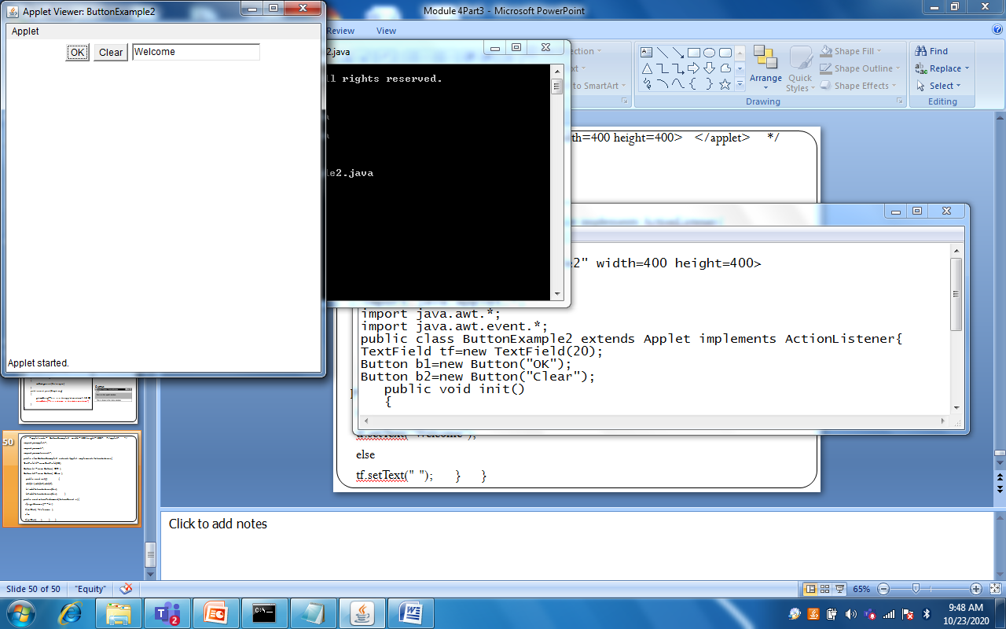
/* <applet code="ButtonExample2" width=400 height=400> </applet> */
import java.applet.*;
import java.awt.*;
import java.awt.event.*;
public class ButtonExample2 extends Applet implements ActionListener{
TextField tf=new TextField(20);
Button b1=new Button("OK");
Button b2=new Button("Clear");
public void init(() {
add(b1);add(b2);add(tf);
b1.addActionListener(this);
b2.addActionListener(this); }
public void actionPerformed(ActionEvent e){
if(e.getSource()==b1)
tf.setText("Welcome");
else
tf.setText(" "); } }

